Slide 2
Root locus sums
FEB 2025

Slide 3

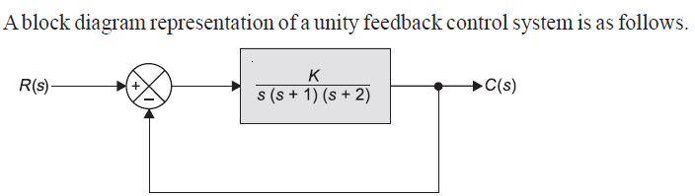

Problems in Root Locus

Slide 4
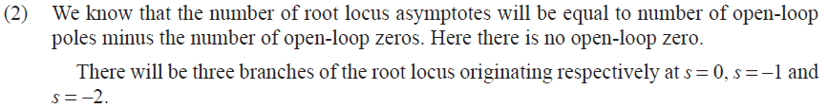
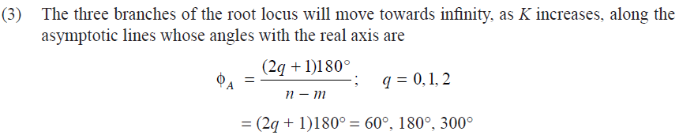
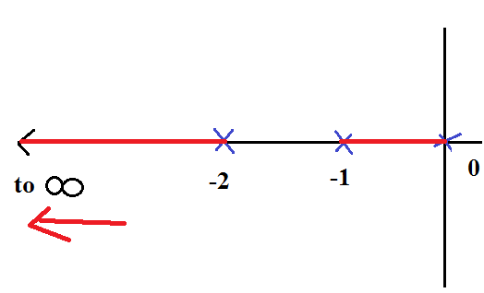


Problems in Root Locus
Angle of Asymptotes

Slide 5
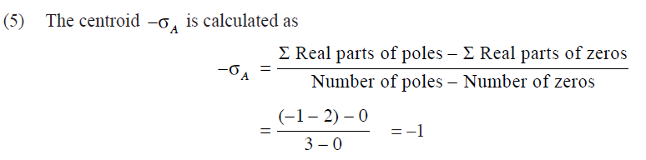
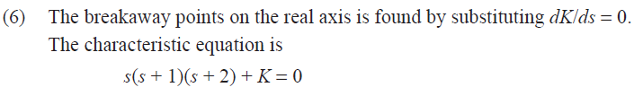
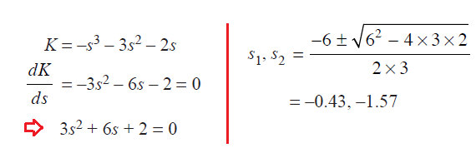

Problems in Root Locus

Slide 6
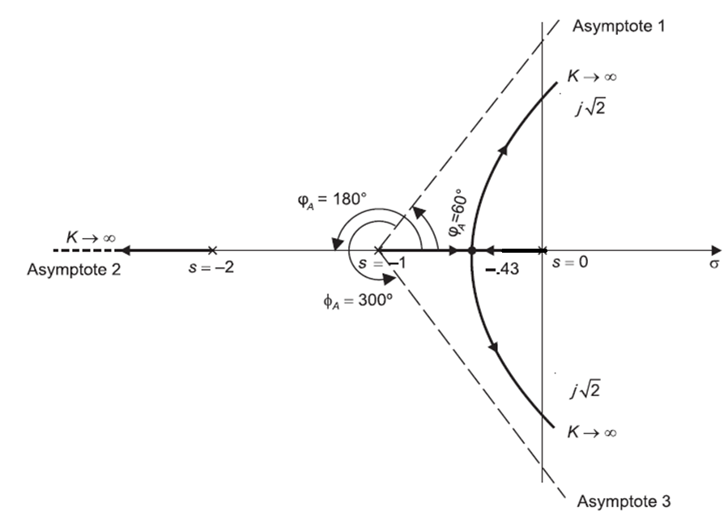
Problems in Root Locus

Slide 7
Problem no. 2

Slide 8
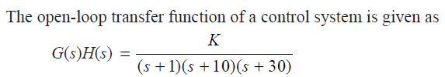


Problems in Root Locus

Slide 9
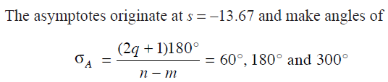

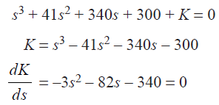


Problems in Root Locus
Angle of Asymptotes

Slide 10
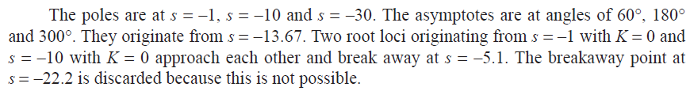
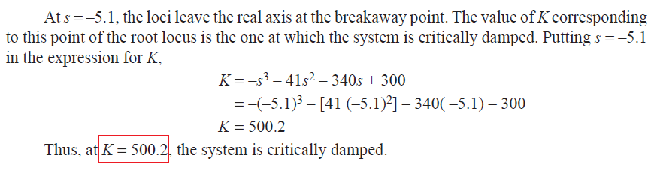
Problems in Root Locus

Slide 11
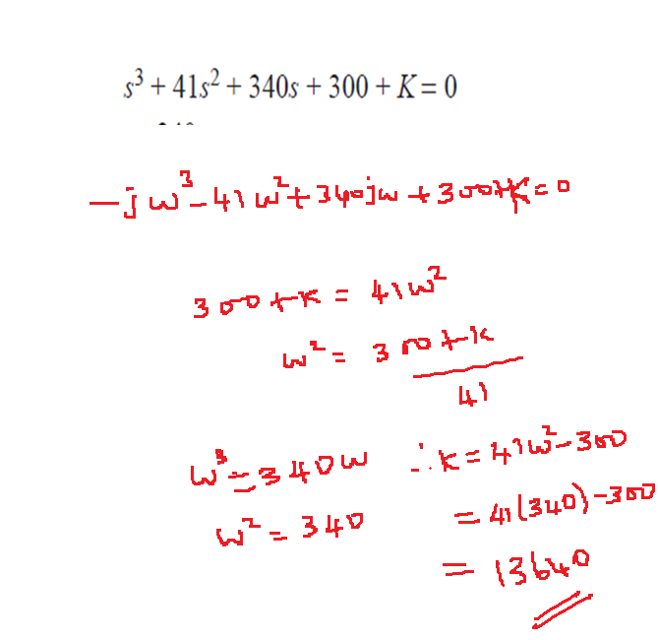
Problems in Root Locus

Slide 12
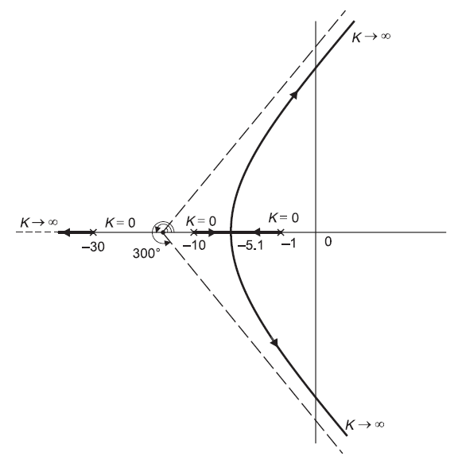
Problems in Root Locus

Slide 13
Problem no. 3

Slide 14
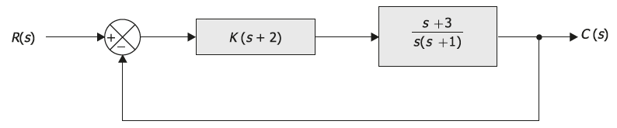

Problems in Root Locus

Slide 15
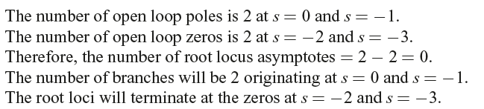
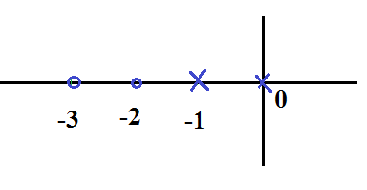
Problems in Root Locus

Slide 16








Problems in Root Locus

Slide 17
Problems in Root Locus

Slide 18
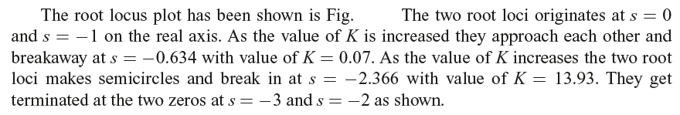
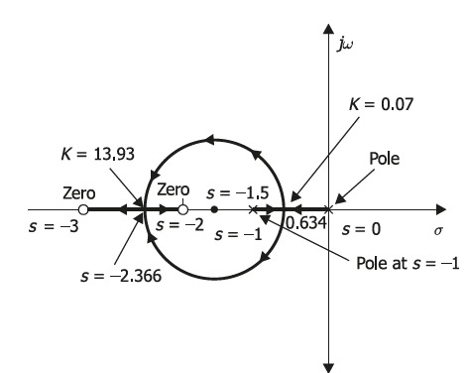
Problems in Root Locus

Slide 19
Problems in Root Locus

